Slide 1

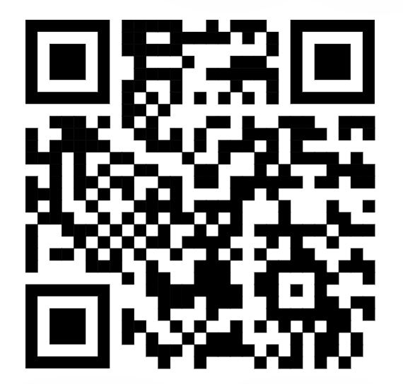
MANUFACTURE DASHBOARDS
AI ASSISTANT
TEAM: SKYRIM
Project: 11AI
Sergei Miller
Ivan Cheprasov
Irving Wang
Rongwei Ma
Notes:
We would like to have a slide looks tech and a bit fancy. (maybe also a bit darker blue??)
We are not sure what kind of paten or image would be adding here yet. Feel free to add and edit it.

Slide 2
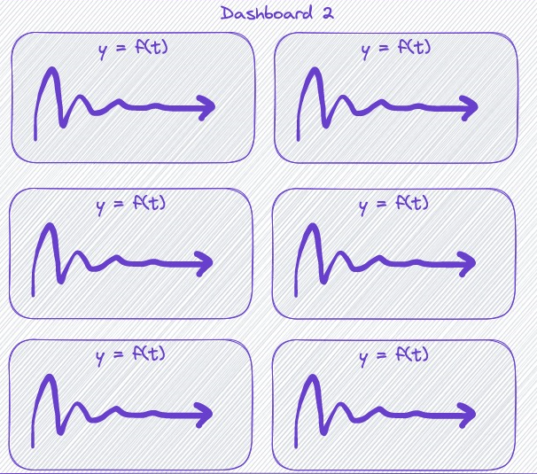
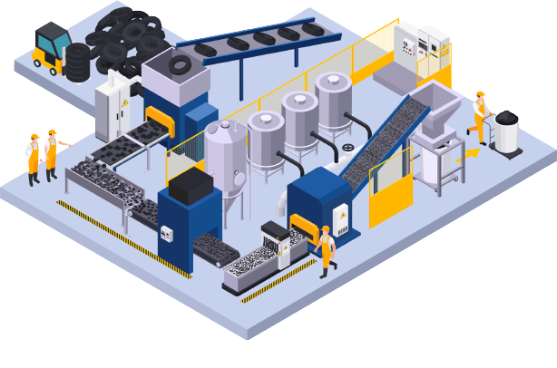
PROBLEM →
In manufacturing the alerts take long time to find the reason behind.
Notes:
Feel free to edit it.

Slide 3
PROBLEM →
TIME CONSUMPTION
HIGHER COST
SOLUTION UNCLEAR
Employee spend long time to find the reason caused the problem.
Spending more time means more higher cost.
Employee need to use
exclusion method
to find the solution.
Notes:
Feel free to edit it.

Slide 4
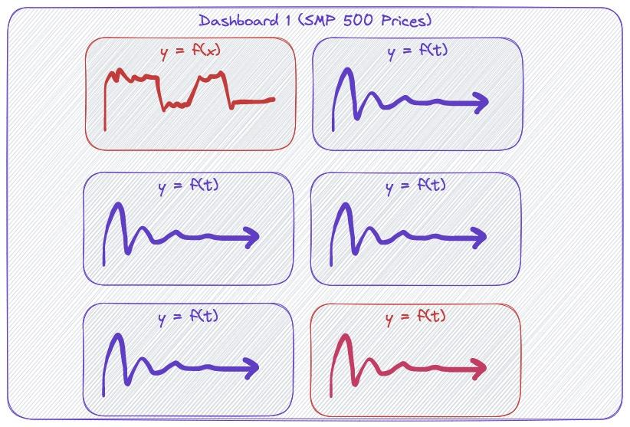
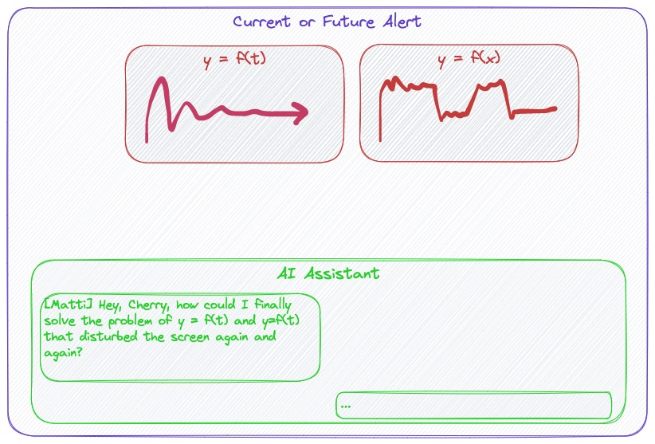
11AI SOLUTION →
⚫ One Dashboard with alerts
⚫ Extract the context of the question
⚫ Human readable solution
⚫ History data search index
Use LLM to suggest the reason behind.
Notes:
Feel free to edit it.

Slide 5
11AI SOLUTION →
REAL TIME
SUSTAINABLE
COMPREHENSIVE
ACCURACY
The sensor information and data is rea-time transferred to search index and process by the LLM.
Based on precalculated search index, LLM and Web UI, the solution balanced the cost and efficiency.
The solution collects multi-source data and information, which is able to answer question from different aspects.
The solution reduces the hallucination and provides more accurate answer based on the real data.
120%
https://github.com/stanfordnlp/dspy/tree/v1
Notes:
Feel free to edit it.

Slide 6
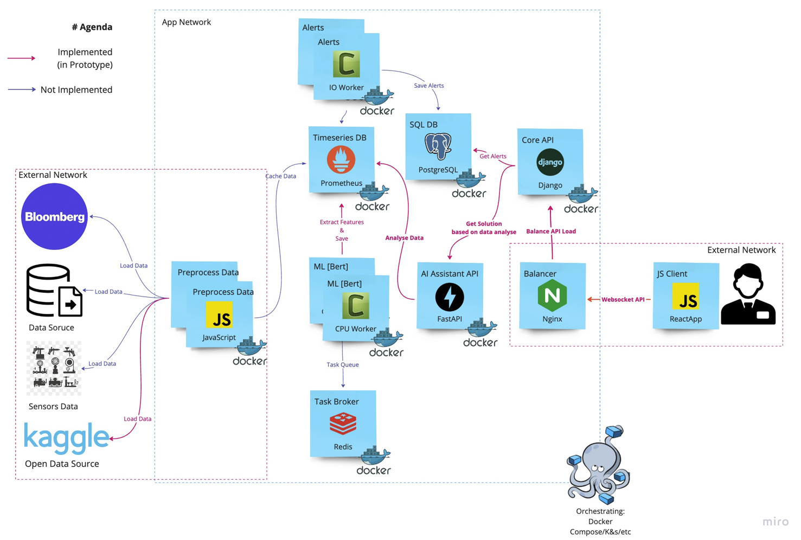
11AI SOLUTION ARCHITECT
Notes:
Feel free to edit it.

Slide 7
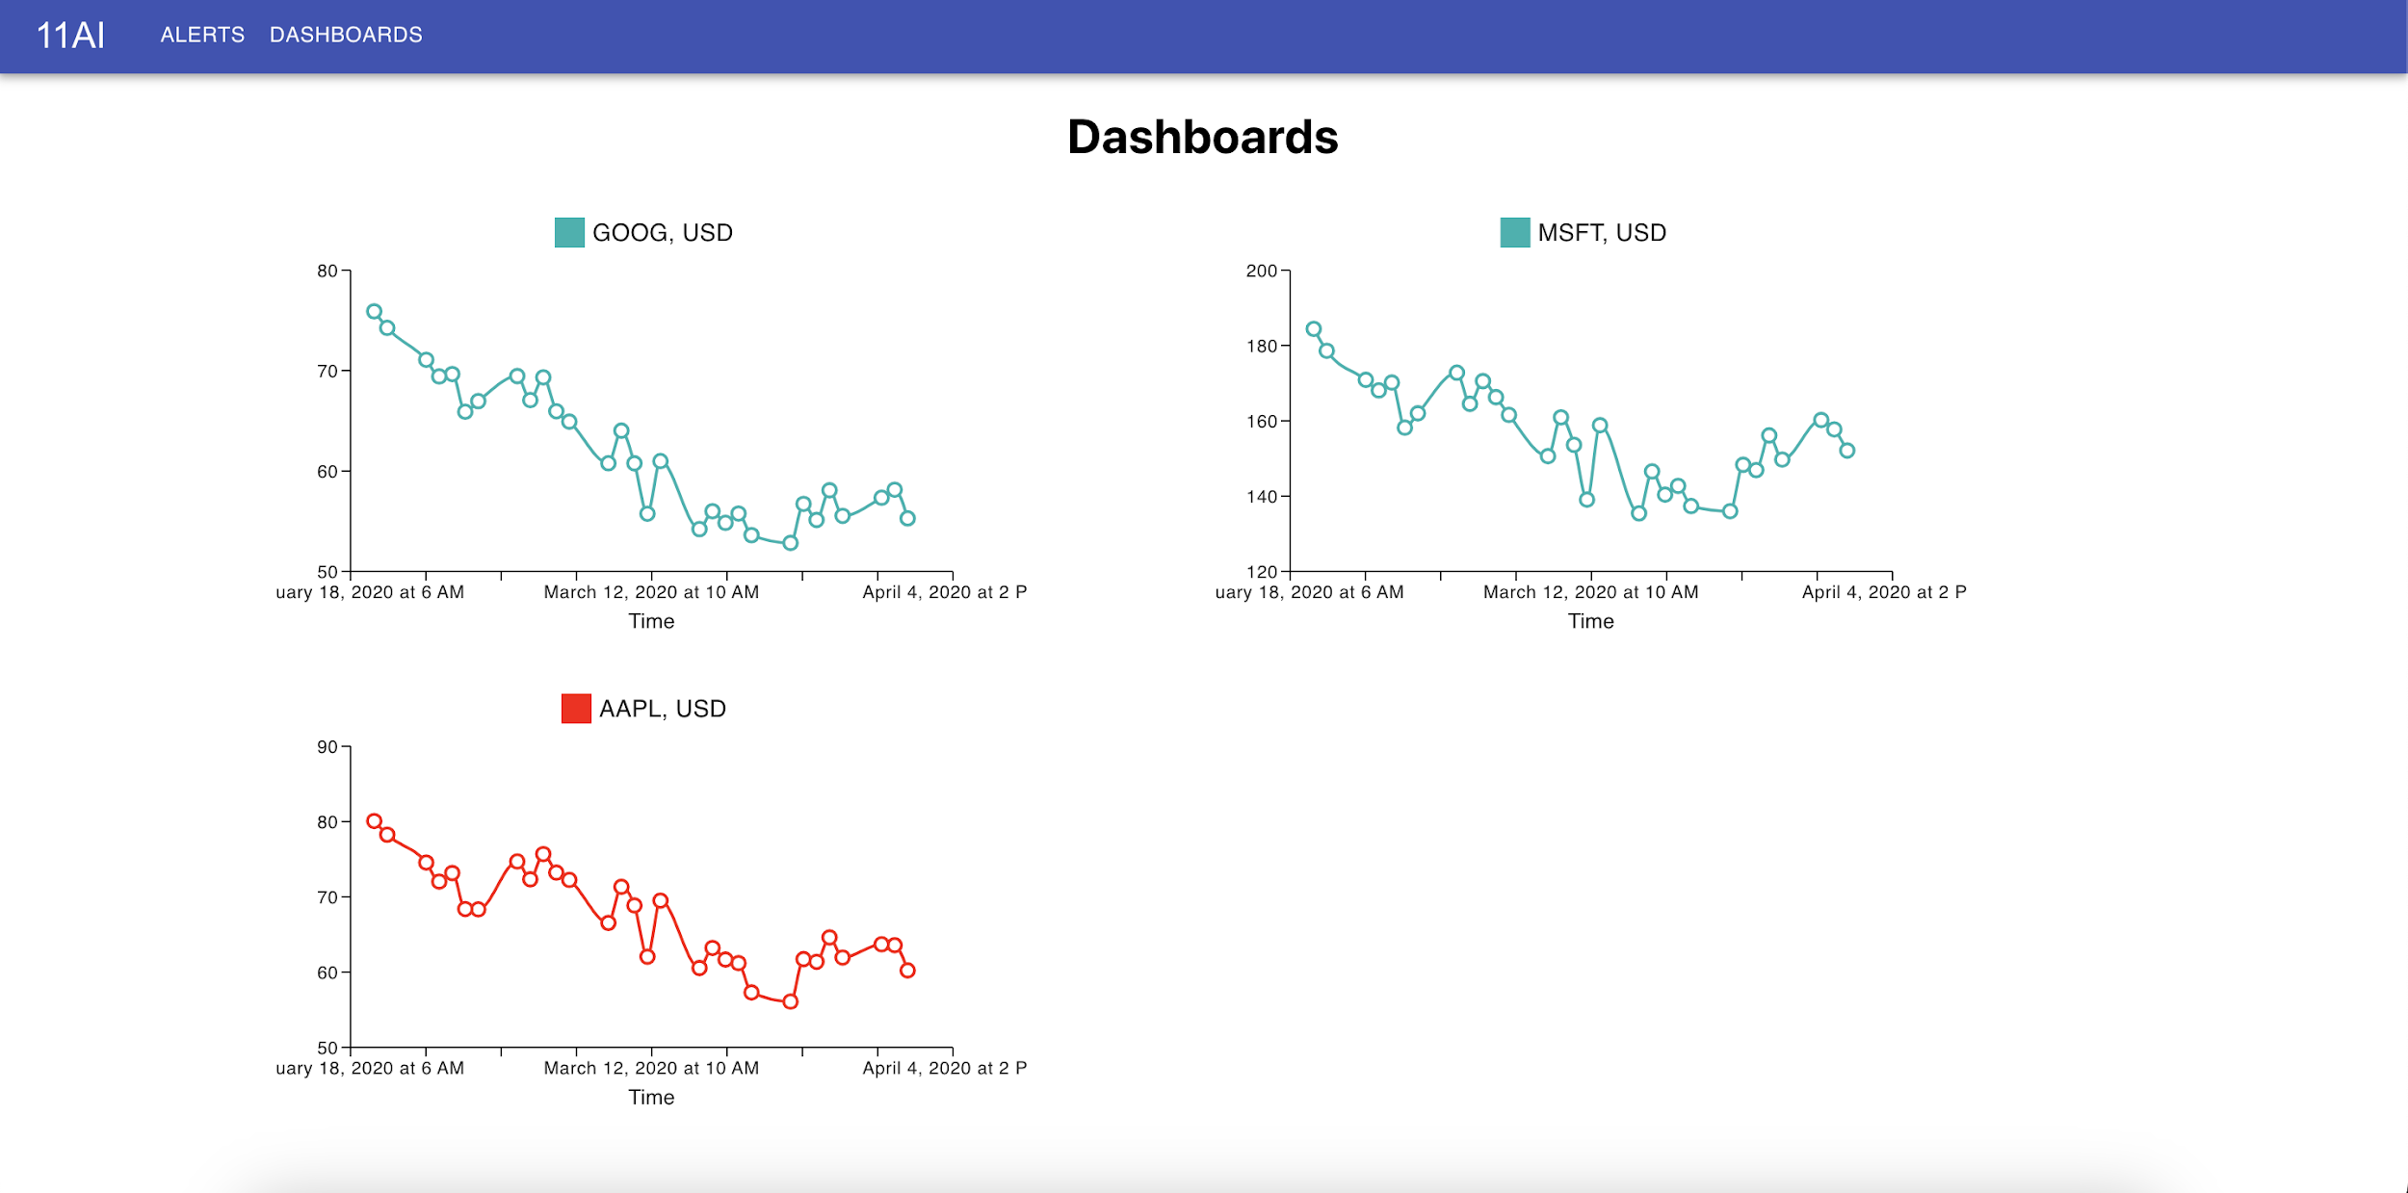
DASHBOARD →
Notes:
Feel free to edit it.

Slide 8
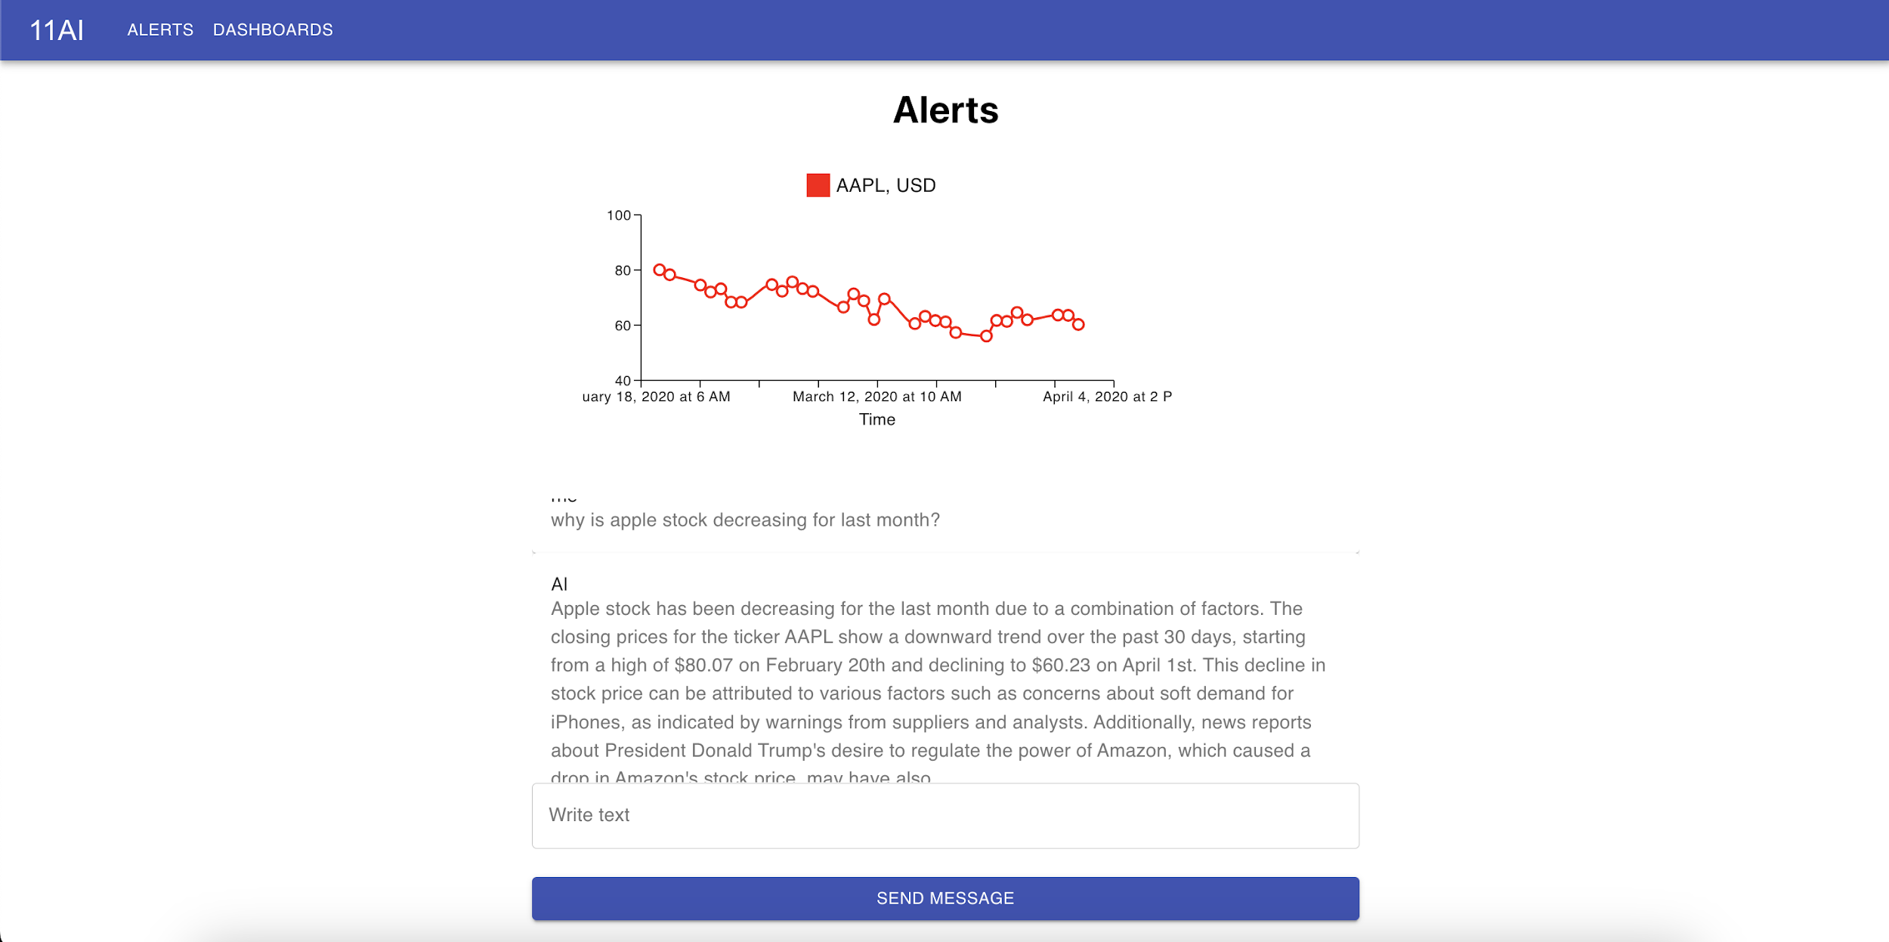
USE CASE DEMO →
Use LLM to simplify the process and directly provide user the solution and information.
Notes:
Feel free to edit it.

Slide 9
EXTENSION →
Easily replace with other LLM
Comparison different LLM solutions
Our solution is easy replace with other LLM like Bert, GPT-4, Llama and so on.
Our solution can further make comparison to see the difference and performance of different LLM solution.
Easily add functions in the chat
Assistant prediction and classification
The solution can easily integrate with other functions.
Our solution can be developed to make prediction or classification for the existed data. And presents the graph in our application.
Notes:
Feel free to edit it.

Slide 10

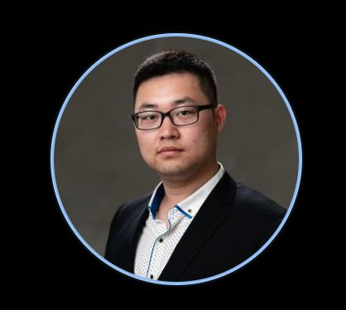
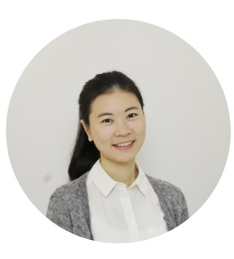
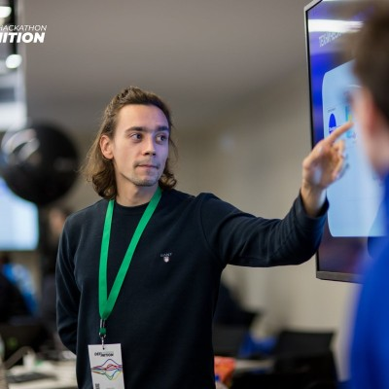
Skyrim Team →
Sergey Miller
Irving Wang
ML Engineer, Joom
discord: sergmiller
Financial Artist,
Jack of all trades
discord: irvingk
Rongwei Ma
Ivan Cheprasov
ML Engineer
discord: summer_64205
SWE, Fluence Labs
discord: Half-PhD#4215
Notes:
Feel free to edit it.

Slide 11
Acknowledgment →
Partners
Matti Aksela
Victoria Mielck
Jaakko Kuukasjärvi
Severi Saastamoinen
Junction Team
Notes:
Feel free to edit it.

Slide 12
Thank you
Notes:
Feel free to edit it.

